Slide 1



PASSENGER POSITIONING SYSTEM
System Analysis And Design

Slide 2

Table Of Contents
01
02
Introduction
Implementation overview
03
04
Architectural Overview
Design and Implementation plan

Slide 3


Introduction
Overview
Architecture
Design

Slide 4
Implementation Overview
Here we describe the interaction of the user with the system’s interface.
Passengers
Hired drivers
Freelance drivers

Slide 5

Architectural overview
A visual representation of the elements that make up the system aids in a better understanding of the latter. It is as follows:
01
02
03
04
05
Users
Interfaces
Use cases
Data
Technology enablers

Slide 6

Design and implementation plan
The following Unified Modelling Language diagrams were used for the design of the Passenger Positioning system:
Dataflow diagram;
Use case diagram;
Class diagram;
Activity diagram;
Sequence diagram.

Slide 7
Dataflow diagram
This illustrates the flow of information through a process or system. It shows the data inputs and outputs, the data stores and the processes through which data moves within our software and optimizes the flow of data.

Slide 8
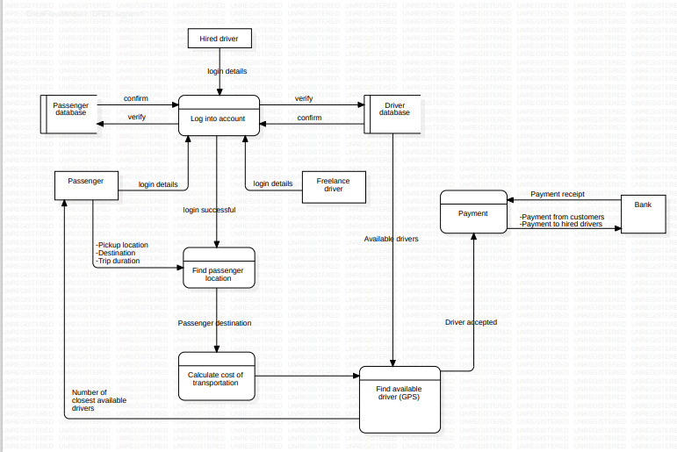
Dataflow diagram

Slide 9
Use case diagram
A graphic representation of the interactions between the system and it’s actors. It identifies the requirements and defines the scope of the passenger positioning system software.

Slide 10
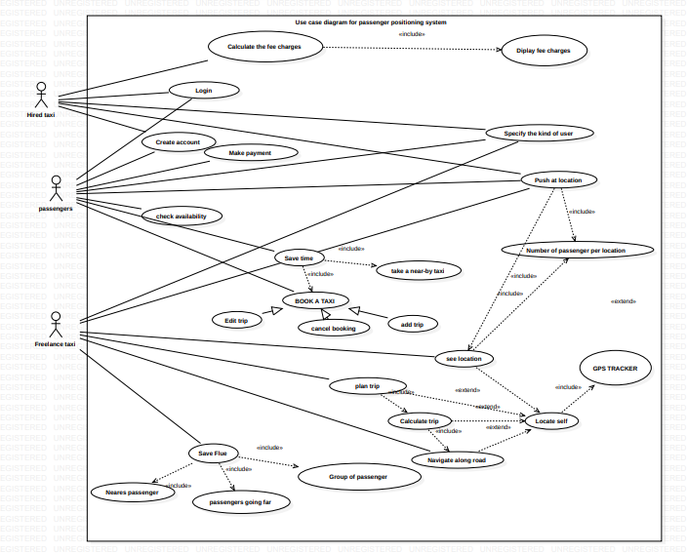
Use case diagram
Someone Famous

Slide 11
Class diagram
It presents a blueprint of the objects that make up a system. Such a diagram models the static structure of the passenger positioning system and thus provides a high-level view of its components and their relationships

Slide 12
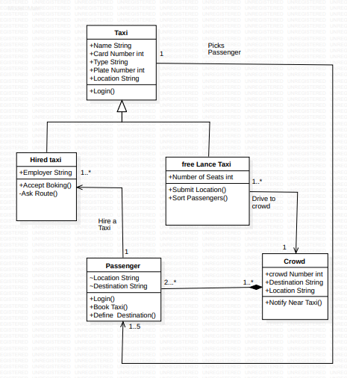
Class diagram

Slide 13
Activity diagram
A flow chart that models flow of activities within a system. It depicts the actions, decisions and branching paths that occur during the execution of an activity.

Slide 14
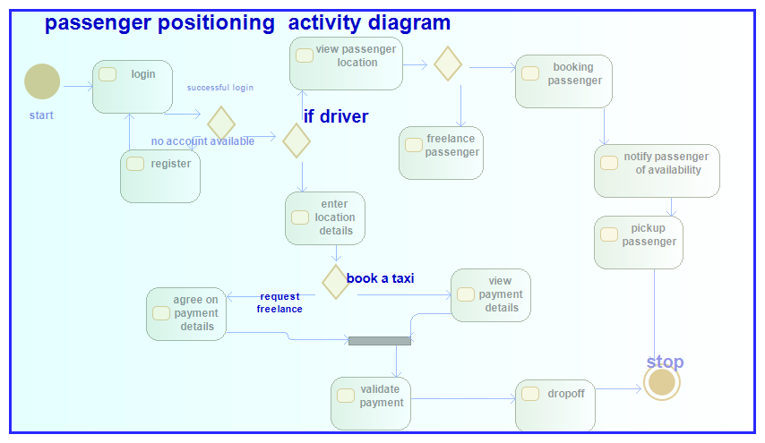
Activity diagram

Slide 15
Sequence diagram
It details how operations are carried out within the system. It illustrates the flow of interaction between the different components of the passenger positioning system.

Slide 16
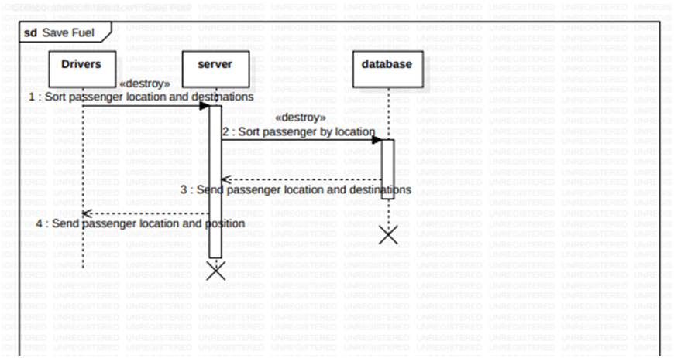
Sequence diagram

Slide 17
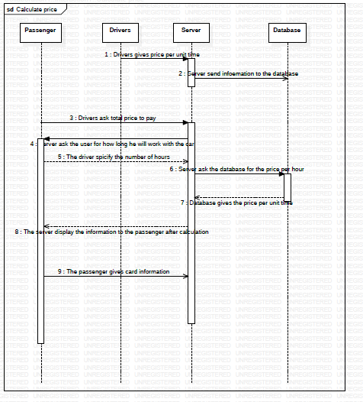
Sequence diagram

Slide 18
Thank you

